Slide 1
Factory Automation and Control Methods
Lecture 8: Industrial Robotics
Daro VAN
Paragon International University
Faculty of Engineering
Department of Industrial Engineering

Slide 2
Outline
Robot Anatomy and Related Attributes
Robot Control Systems
End Effectors
Applications

Slide 3
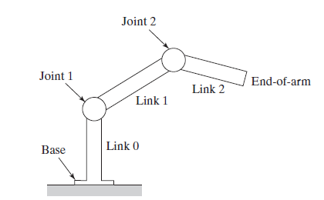
Robot Anatomy and Related Attributes
Joints and Links

Slide 4
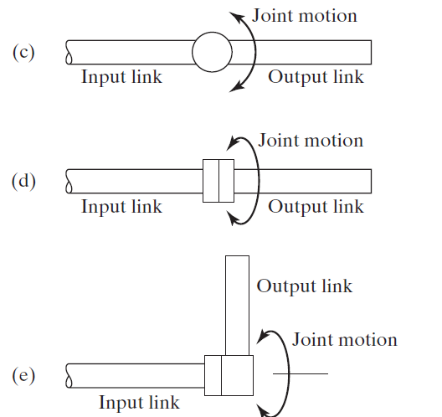
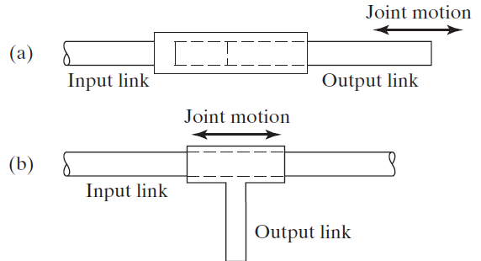
Robot Anatomy and Related Attributes
Joints and Links
Five types of joints commonly used in industrial robot construction: (a) linear joint (type L joint), (b) orthogonal joint (type O joint), (c) rotational joint (type R joint), (d) twisting joint (type T joint), and (e) revolving joint (type V joint).

Slide 5
Robot Anatomy and Related Attributes
Common Robot Configurations
A robot manipulator can be divided into two sections:
Body-and-arm assembly
Use to position of the end effector
Wrist assembly
Commonly have an end effector (gripper or tools to perform some processes

Slide 6
Robot Anatomy and Related Attributes
Common Robot Configurations
A robot manipulator can be divided into two sections:
Body-and-arm assembly
Use to position of the end effector
Wrist assembly
Commonly have an end effector (gripper or tools to perform some processes

Slide 7
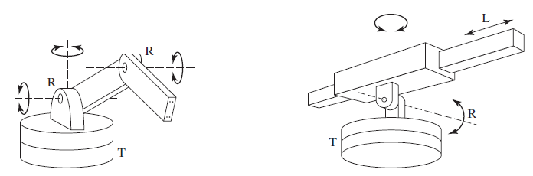
Robot Anatomy and Related Attributes
Body-and-arm Configurations
Articulated robot (jointed-arm robot)
Polar configuration

Slide 8
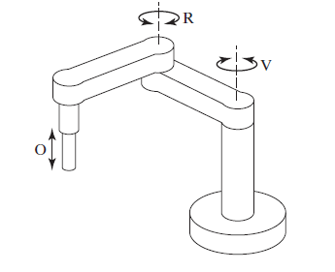
Robot Anatomy and Related Attributes
Body-and-arm Configurations
SCARA configuration

Slide 9
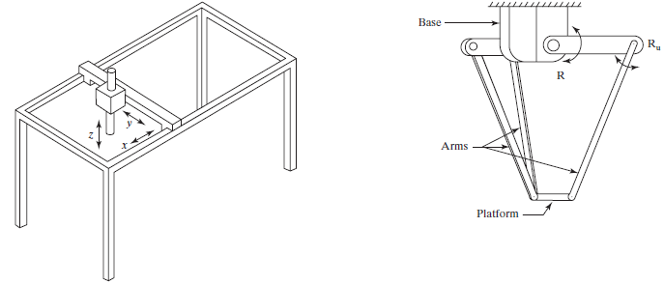
Robot Anatomy and Related Attributes
Body-and-arm Configurations
Cartesian coordinate robot
Delta robot

Slide 10
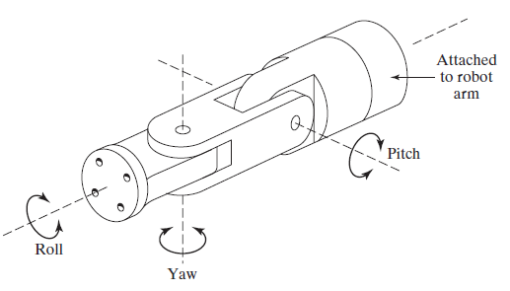
Robot Anatomy and Related Attributes
Wrist Configurations
The robot’s wrist is used to establish the orientation of the end effector
Typical configuration of a three-axis wrist assembly showing roll, pitch, and yaw.

Slide 11
Robot Anatomy and Related Attributes
Joint Notation System
The manipulator is described by the joint types that make up the body-and-arm assembly, followed by the joint symbols that make up the wrist.
For example, the notation TLR:RT represents a five-axis manipulator whose body-and-arm is made up of a twisting joint (joint 1 = T2), a linear joint (joint 2 = L), and a rotational joint (joint 3 = R). The wrist consists of two joints, a rotational joint (joint 4 = R) and a twisting joint (joint 5 = T).

Slide 12
Robot Anatomy and Related Attributes
Joint drive systems
Robot joints are actuated using any of three types of drive systems:
Electric : Use electric motors as joint actuators
Ex servomotors, stepper motors
Connect to the joints either using no gear reduction (called direct drive) or a gear reduction to increase torque or force
preferred drive system in commercially available robots
Hydraulic
linear pistons and rotary vane actuators
can be designed with greater lift capacity
Pneumatic.
linear pistons and rotary vane actuators
limited to smaller robots used in simple part transfer applications.

Slide 13
Robot Anatomy and Related Attributes
Sensors in robotics
Sensors used in industrial robotics can be classified into two categories:
Internal sensors
Ex IMU, accelerometer, gyroscope
External sensor
Limit switch

Slide 14
Robot Anatomy and Related Attributes
Sensors in robotics
Other situations require more advanced sensor technologies, including the following:
Tactile sensors: used to determine whether contact is made between object. Ex touch sensor and force
Proximity sensors: used to indicate when the object is closed to sensor.
Optical sensors: used to detect the presence or absence of the objects
Machine vision: used for inspection, parts identification, guidance.
Others…

Slide 15
Robot Control Systems
Different types of control are required for different applications. Robot controllers can be classified into four categories:
limited-sequence control,
playback with point-to-point control,
playback with continuous path control, and
intelligent control.

Slide 16
Robot Control Systems
Limited-Sequence Control
It can be utilized only for simple motion cycles, such as pick-and-place operations
It is usually implemented by setting limits or mechanical stops for each joint and sequencing the actuation of the joints to accomplish the cycle.
no servo-control to accomplish precise positioning of the Joint

Slide 17
Robot Control Systems
Playback with Point-to-Point Control
the controller has a memory to record the sequence of motions in a given work cycle, as well as the locations and other parameters (such as speed) associated with each motion, and then to subsequently play back the work cycle during execution of the program
individual positions of the robot arm are recorded into memory.
Feedback control is used during the motion cycle to confirm that the individual joints achieve the specified locations
Interlocks are used to coordinate the actions of the robot with the actions of other equipment in the work cell.

Slide 18
Robot Control Systems
Playback with Point-to-Point Control
A playback robot with continuous path control is capable of one or both of the following:
Greater storage capacity
Interpolation calculations. The controller computes the path between the starting point and the ending point of each move using interpolation routines similar to those used in NC.

Slide 19
Robot Control Systems
Intelligent Control
Some of the characteristics that make a robot appear intelligent include the capacities
to interact with its environment,
make decisions when things go wrong during the work
cycle, communicate with humans,
make computations during the motion cycle, and
Respond to advanced sensor inputs such as machine vision.

Slide 20
End Effectors
The two categories of end effectors are
grippers and
tools.

Slide 21
End Effectors
Grippers
Types of grippers used in industrial robot applications include the following:
Mechanical grippers: consisting of two or more fingers that can be actuated by the robot controller to open and close on the work part.
Vacuum grippers: used to hold flat objects.
Magnetized devices: used for holding ferrous parts
Adhesive devices : used an adhesive substance to hold a flexible material such as a fabric
Simple mechanical devices, such as hooks and scoops.

Slide 22
End Effectors
Grippers
Some of the innovations and advances in mechanical gripper technology include:
Dual grippers
Interchangeable finger
Sensory feedback in the finger
Multiple-fingered grippers

Slide 23
End Effectors
Tools
tools used as end effectors by robots to perform processing
applications include
spot welding gun,
arc welding tool;
spray painting gun; rotating
spindle for drilling,
routing,
grinding, and
similar operations; assembly tool (e.g., automatic screwdriver); heating torch; ladle (for metal die casting); and water jet cutting tool.

Slide 24
Applications of Industrial Robots
The applications can usually be classified into one of the
following categories:
material handling,
processing operations, and
Assembly
inspection.

Slide 25
Applications of Industrial Robots
Material handing applications
Included within this application category are
material transfer and
machine loading and/or unloading.
the parts must be presented to the robot in a known position

Slide 26
Applications of Industrial Robots
Processing operation
To perform the process, the robot must manipulate the tool relative to the part.
Examples of industrial robot applications in the processing category include:
spot welding,
arc welding,
spray painting,
various machining and other rotating spindle processes.
……….

Slide 27
Applications of Industrial Robots
Other processing application
The list of industrial processes that are being performed by robots is continually growing.
Among these are the following:
Drilling, routing, and other machining processes.
Grinding, wire brushing, and similar operation
Waterjet cutting.
Laser cutting.

Slide 28
Applications of Industrial Robots
Assembly
Assembly involves the combining of two or more parts to form a new entity, called a subassembly or assembly.
The new entity is made secure by fastening the parts together using
mechanical fastening techniques (e.g., screws, bolts and nuts, rivets) or joining processes (e.g., welding, brazing, soldering, or adhesive bonding).

Slide 29
Applications of Industrial Robots
Inspection
Inspections accomplish the following functions:
making sure that a given process has been completed,
ensuring that parts have been assembled as specified,
identifying flaws in raw materials and finished parts.

Slide 30
Applications of Industrial Robots
Economic justification of industrial robots
The general characteristics of industrial work situations that tend to promote the substitution of robots for human labor are the
following:
Hazardous work for humans
Repetitive work cycle.
Difficult handling for humans
Multishift operation
Infrequent changeovers.
Part position and orientation

Slide 31
References
Mikell P. Groover, “Automation, Production Systems and Computer-integrated Manufacturing” , 4th edition, Pearson, chapter 8

